Slide 1
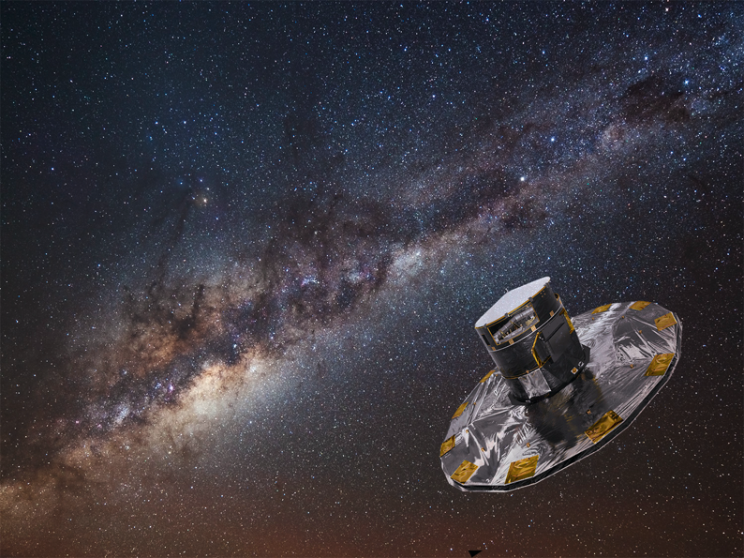
Gaia Early Data Release 3
UK Gaia science platform
Dave Morris
Gaia DPAC: Edinburgh / Cambridge / Barcelona / ESAC
National Astronomy Meeting
19th July 2021
Notes:
Acknowledges credit where credit is due - mention a few names if you like but no real need.

Slide 2


The problem
Existing archive systems are great for
  Examination of (relatively) small subsets of data (e.g. spatially limited)
  Performing very limited server-side manipulation of primitive column types
  …
Large scale analysis limited to
  Pre-defined, pre-baked aspects (e.g. visualisations) OR
  Download the whole catalogue (~ 1TB at EDR3)
Data volume set to grow significantly over the next releases
  DR3: 10s of TB
  DR4+: 100s of TB+
Complexity will increase too
  Time-resolved data, spectra, more advances data products
Large-scale analyses through relational systems are impossible, and wholesale download will be no longer an option ...
Gaia Early Data Release 3 • Dave Morris & the Gaia Collaboration • 19th July 2021• UK National Astronomy Meeting
Notes:
Need to emphasise that this is no criticism: the existing relational systems (Gaia archive at ESAC, CDS, ARI, …) are very good at what they do. It’s just that they’re all built on, and hence limited by, TAP-ADQL on RDBMS architecture.

Slide 3

A simple example: mean angular motions over the sky
Existing TAP services built on relational technology
  Limited set of aggregate functions, e.g. no robust estimation
  No provision for user-defined functions
  Execution time > 1hr 30min
In reality wish to do much more than basic statistical aggregates, e.g.
  User-defined statistical aggregates
  Higher order statistics
  Machine Learning
  …
Gaia Early Data Release 3 • Dave Morris & the Gaia Collaboration • 19th July 2021• UK National Astronomy Meeting
Notes:
It’s tricky to do even simple things at EDR3 data volumes!
This query is very basic, almost naive. Mean (AVG()) quantities are not robust and even the simplest robust estimators (e.g. median) are not covered by ADQL. So the result of the above may not be very useful, always assuming it runs to successful completion (need a GACS login to execute this, otherwise it times out under default resource limits!), and general statistical analysis is not supported. Note the use of the HEALPix index encoded in the 4 most significant bytes of source_id is employed here as the buckets within which to aggregate uniformly over the sky.
Anyone who says “just download the catalogue” or “sub-sample the catalogue somehow” or even “at Data Centre X we can add index Y or UDF Z” (to make any given specific query run inside the time-out limit or provide specific functionality) is missing the point!

Slide 4

Gaia science platforms
Gaia DPAC have been investigating Apache Spark for a “big data” platform-as-a-service to provide
Scale-out data handling
High performance distributed computing
Familiar web notebook environment
Familiar APIs in Python
in an end-user “code-to-data” service: the Gaia Data Analysis Framework
Gaia Early Data Release 3 • Dave Morris & the Gaia Collaboration • 19th July 2021• UK National Astronomy Meeting
Notes:
Key features are scalability via distributed processing, flexibility via end-user programmability, and versatility with familiar APIs and numerical algorithm implementations like ML. There is even a familiar SQL API against which to programme the initial parts of workflows (BUT note that programmability is much more extensive than the limited capabilities of ADQL). Follows the paradigm of moving code to the data (in common with nearly all modern large-scale survey projects in astronomy, e.g. LSST).

Slide 5
UK Gaia science platform
UK Gaia project is deploying the Gaia Data Analysis Framework on STFC’s computing cloud e-infrastructure “IRIS”
Prototype working now (see following demo slides)
Aiming to have end-user service in place by DR3 (end Q2 next year)
Looking for interested parties to beta-test the system based on EDR3
Gaia Early Data Release 3 • Dave Morris & the Gaia Collaboration • 19th July 2021• UK National Astronomy Meeting
Notes:
Note: no pre-release access to the full DR3+ data (in case anybody thinks they’ve spotted a back-door)!

Slide 6
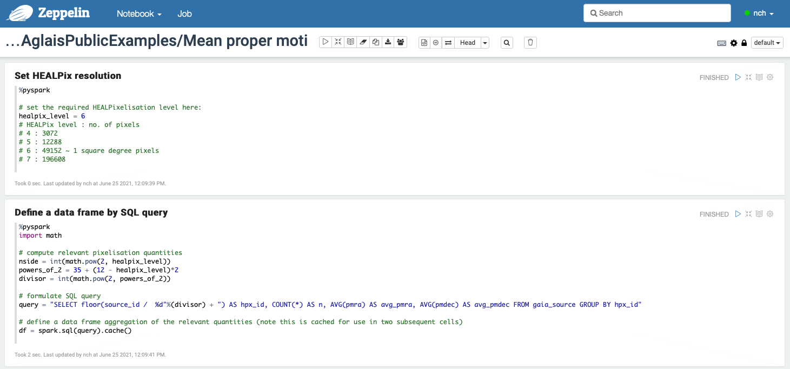
Simple example : mean angular motions over the sky
Gaia Early Data Release 3 • Dave Morris & the Gaia Collaboration • 19th July 2021• UK National Astronomy Meeting
Notes:
Point out a few key things: notebook environment with cells; SQL-like API, plotting with matplotlib; and above all, it works in a few minutes. Emphasise the API is not limited to the provided aggregate functions - you can define your own (UDFs) for use within the API, or you can manipulate programmatically (and efficiently) the rich data frame objects via the underlying distributed processing engine.

Slide 7
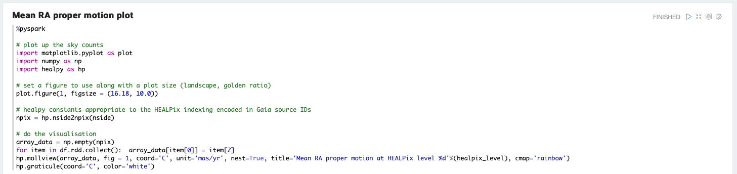
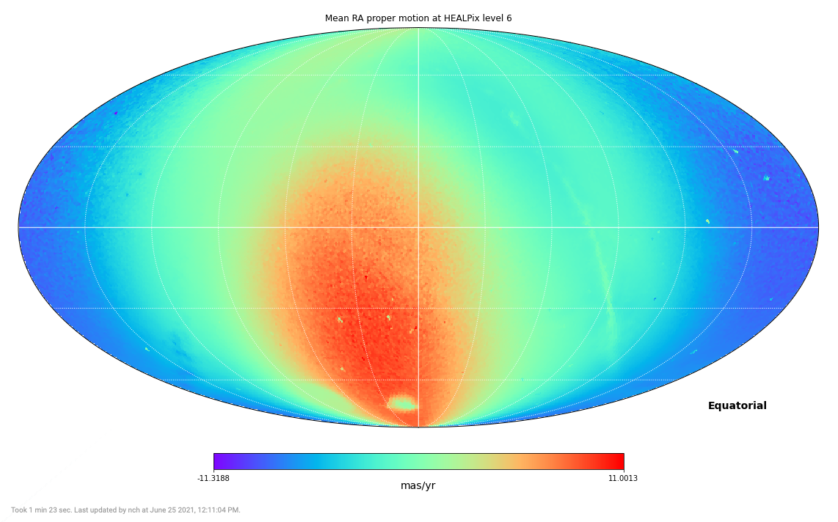
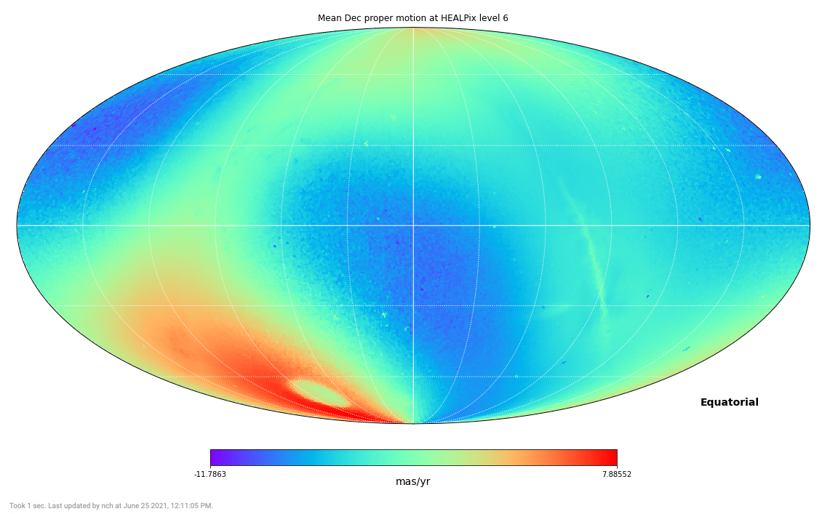
1min 28sec to run the query and plot the graph
Notes:
Science bit: the “dipole” (very blue in one direction, red opposite) shows reflex motion from the Sun moving in it’s orbit in the Galactic disk. The bright spot in the red in both plots is the Large Magellanic Cloud, a satellite galaxy of our own, which has a peculiar angular motion all of it’s own.
Note the execution time (tiny fonts at the bottom): 1m 23s!

Slide 8
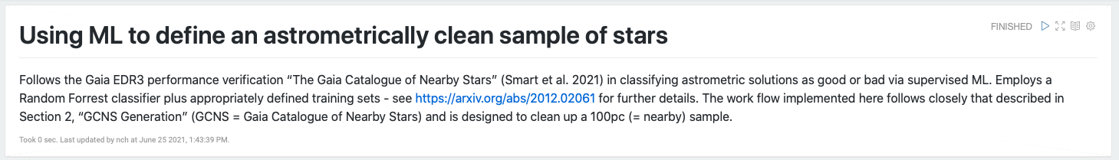
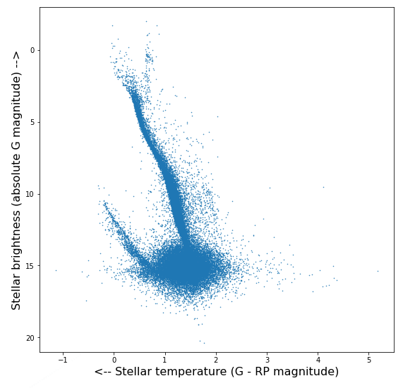
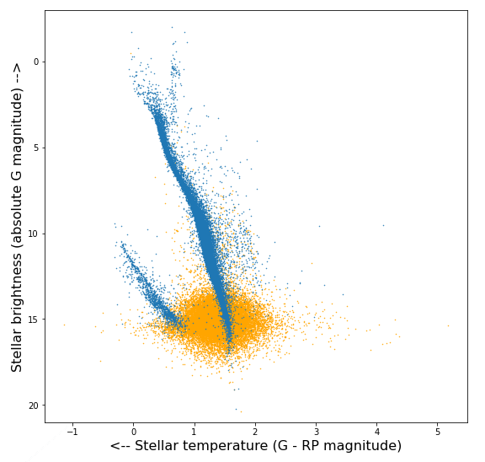
Complex example : Random Forest ML classifier
Train a RandomForest decision tree to classify good and bad astrometric solutions
6min to create the training data and train the classifier
25sec to classify 1,724,028 sources and plot the results
Notes:
For any science details, point people to the linked EDR3 paper “The Gaia Catalogue of Nearby Stars” (Smart et al. 2021). Emphasize
More complex workflow involving sample selection, supervised ML, analysis and plotting of results
All necessary packages provided by default
Reasonable response time (around 10 minutes in this case) enables exploration of data using such techniques
Suggest to keep a pdf of the notebook handy, as well as the web notebook open on the system, then if anybody asks for more technical details you can show them the relevant cell in the notebook.

Slide 9
Beta testing
Call for people interested in being beta testers
Booked sessions with tech support
Q4 2021
Outline of the science case you would like to explore
Outline of the technology or algorithm you are interested in using
Contact a member of the development team
Nigel Hambly <nch@roe.ac.uk>
Dave Morris <dmr@roe.ac.uk>
Stelios Voutsinas <stv@roe.ac.uk>
Interested in the most likely to break the system
Gaia Early Data Release 3 • Dave Morris & the Gaia Collaboration • 19th July 2021• UK National Astronomy Meeting
Notes:
We need to make it clear when this will be available, and who to contact to get access.

